Slide 1

Continues Integration
Stav Alfi

Slide 2
What it should be like…

Slide 3
How it is today…

Slide 4
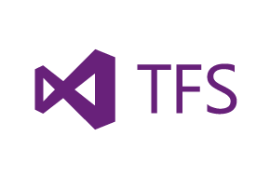
TFS
Source control
Dependency manager
Compilation + tests environment

Slide 5


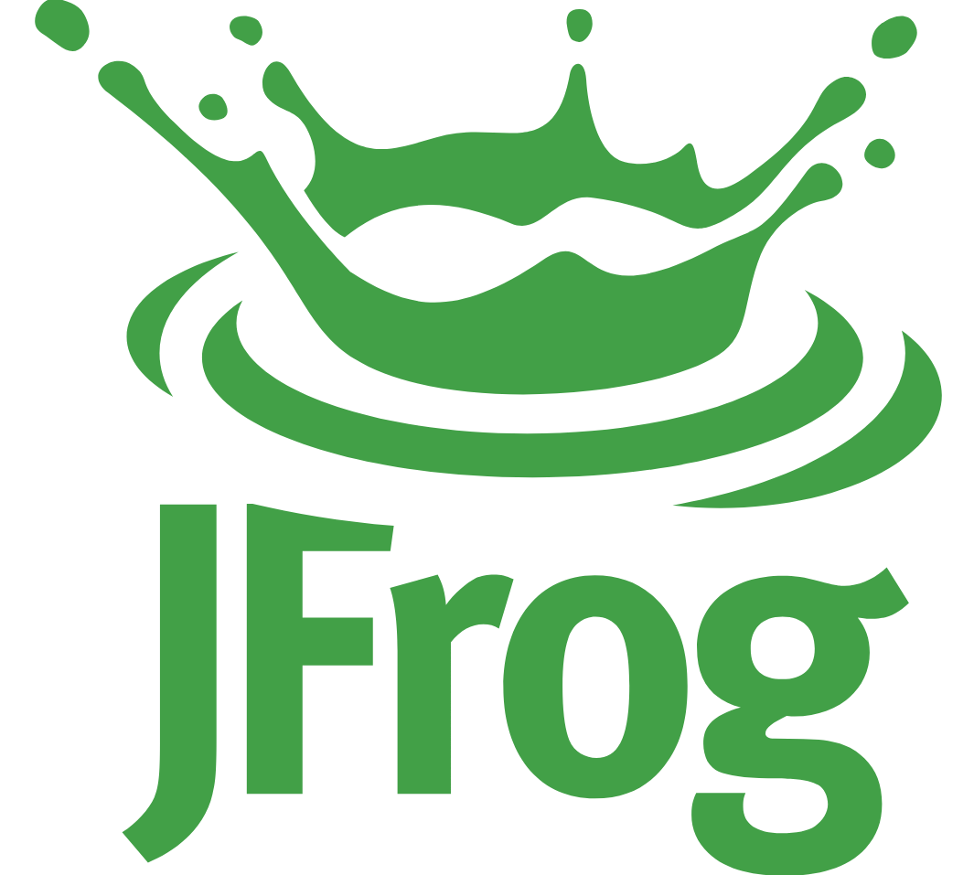
Jenkins + Artifactory + SCM
Source control + SCM – Git + Git-TFS
Artifactory – JFrog
Jenkins – Imperative build + deployment processes
Cons:
Git-TFS try to be Jenkins also and fail.
Jenkins doesn’t have any support to Git-TFS.
Jenkins provide imperative work flow.
Jenkins plugins have limitation and bugs.
Multiple flows.

Slide 6
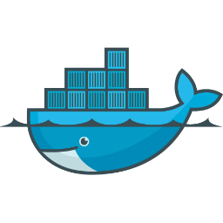
Jenkins + Artifactory + SCM + Deployment
Source control + SCM – Git + Bitbucket
Artifactory – JFrog
Jenkins – Imperative build process
Deployment – Docker
Cons:
Jenkins provide imperative work flow.
Jenkins plugins have limitation and bugs.
Design + construct + Maintain Builds.

Slide 7

Build Manager + Artifactory + SCM + Deployment
Source control + SCM – Git + Bitbucket
Artifactory – JFrog
Build manager – CircleCI
Deployment – Docker

Slide 8
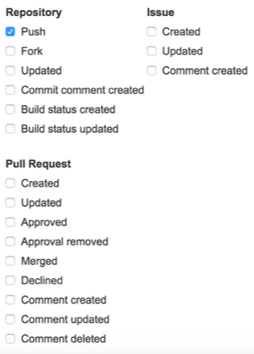
Bitbucket

Slide 9
Today vs tomorrow
 | Today | Tomorrow
Knowledge | Build Team /Jenkins /Git-TFS - Imperative | Circle-CI - Declarative
Work | Design + construct + Maintain | design – No integration needed
Machines | Dependencies, configurations

Slide 10
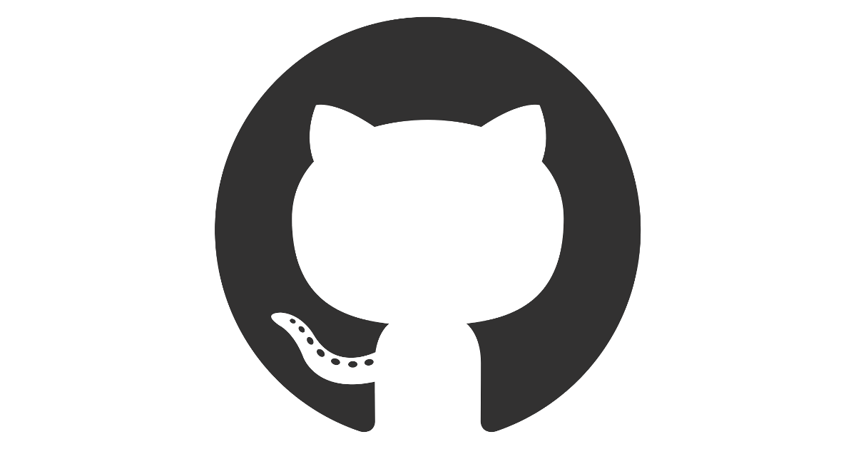
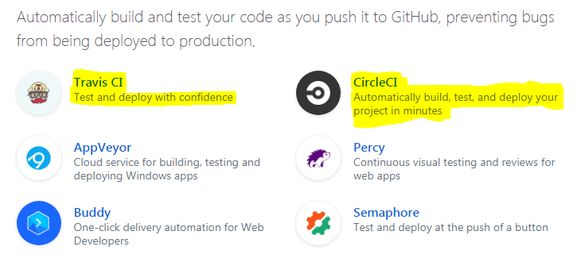
GitHub - Continues Integration

Slide 11

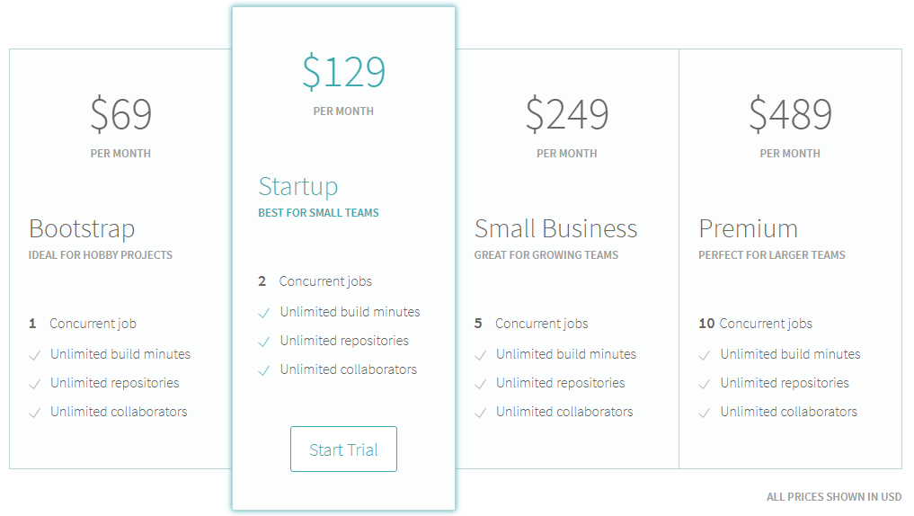
Travis CI – Continues Integration

Slide 12
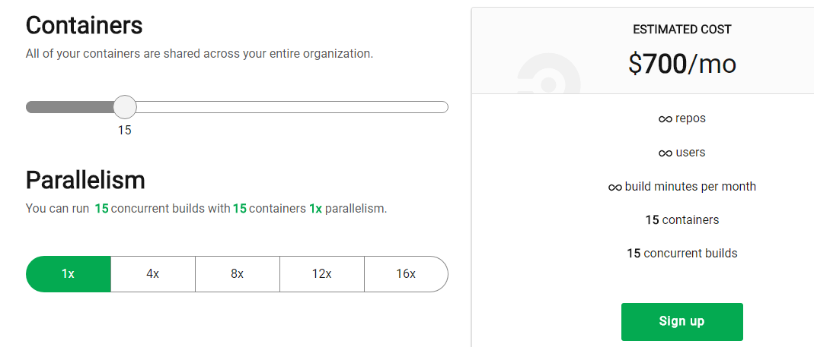
Circle CI – Continues Integration

Slide 13
Jenkins – Continues Integration
Rent Virtual machine on our clouds.
Create 300 containers using Swarm / Kubernetes.
Run builds on them.

